Slide 1
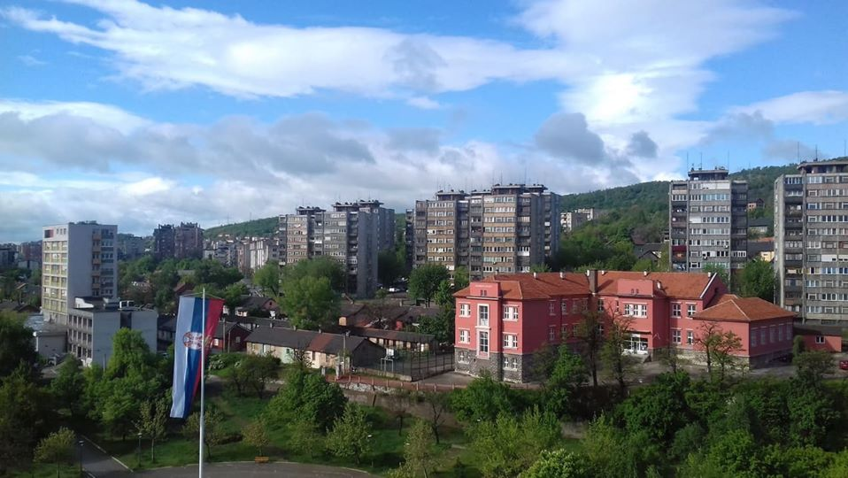
THE CITY OF BOR

Slide 2
Location of the City of Bor
The City of Bor is located in the east of the Republic of Serbia, between the City of Zajecar and municipalities Negotin, Majdanpek and Žagubica, Despotovac and Boljevac.
The proximity of borders with Bulgaria and Romania is characteristic.
Most of the territory is mountainous. It belongs to the Timok or Danube basin.
The City of Bor belongs to the Bor district and covers an area of ​​856 km2 with a population of 48,615 (according to the 2011. census) or 57 inhabitants per km2.

Slide 3
Location of the City of Bor
Connection with the main road - highway E-75 (Belgrade - Skopje) is possible over 4 routes, namely: 87 km long via Boljevac and Paracin; 150 km long road through Zajecar, Knjazevac and Nis, the road through Žagubica, Kučevo and Požarevac about 158 km long, and the road across Zagrađe and Miloševa kula, about 205 km long.

Slide 4
Location of the City of Bor
By its natural features, Bor and its surrounding are one of the most interesting geographical units in Serbia due to its geographical characteristics, morphology and geology of the ground, climatic conditions and complex historical development of the living world.
The natural resources of Bor include, not only deposits of copper and gold rich in ores, but also oases of untouched nature in its immediate vicinity. The western part of Bor Municipality belongs to the mountain complex of South Kučaj. Due to its attractiveness and variety of surface forms of relief, the karst surface of Dubašnica stands out, with an area of about 70 km2. Zlot caves and canyon of Zlot river, are characterized by the presence of rare species of flora and fauna. Lazar's cave is arranged for tourist visits.
The eastern part is covered by the mountains : Mali and Veliki Krš, Stol, Deli Jovan and the Gornjane plateau. The area of these predominantly limestone ridges and areas is about 50 km2.

Slide 5
CITY OF BOR - POPULATION
The results of the census in 2011. show that 48,615 people live in Bor Municipality (they account for 0, 7% of the total population of Serbia and 38, 1% of Bor District).
The City of Bor consists of the central settlement and the headquarters of the City - the urban settlement Bor and 12 villages: Gornjane, Tanda, Luka, Krivelj, Bučje, Ostrelj, Donja Bela Reka, Brestovac, Slatina, Zlot, Šarbanovac and Metovnica.
The City of Bor is also the seat of the Bor district, which, in addition to Bor, consists of the municipalities of Kladovo, Majdanpek and Negotin.

Slide 6
Total population, households and apartments in 2011.

Slide 7
EMPLOYMENT AND EARNINGS
Employment and earnings
Registered employees* ¹
by municipalities of work | 12598 | (2019)
by municipalities of residence | 13456 | (2019)
Registered employees* by municipalities of residence comparing to population number (%)¹ | 30 | (2019)
Average annual net salaries and wages (RSD)¹ | 61031 | (2019)
Registered unemployed** ² | 4306 | (2019)
Registered unemployed per 1,000 inhabitants² | 96 | (2019)
* From 2015 the data include registered individual farmers
** state as of 31.12.
Source:
¹ Statistics of Employment and Earnings, SORS
² National Employment Service
* From 2015 the data include registered individual farmers
** state as of 31.12.
Source:
¹ Statistics of Employment and Earnings, SORS
² National Employment Service

Slide 8
SMALL AND MEDIUM ENTERPRISES AND ENTREPRENEURS
Active companies and entrepreneurs
Active companies |  | 394 |  |  | (2019)
Active entrepreneurs |  |  |  | 1128 | (2019)
Incentives of regional development (RSD thousand) |  | 344409 |  |  | (2018)
Source: Serbian Business Registers Agency
Source: Serbian Business Registers Agency

Slide 9
SMALL AND MEDIUM ENTERPRISES AND ENTREPRENEURS

Slide 10
TABLE OF FINANCING OF PRIORITY MEASURES OF THE ACTIVE EMPLOYMENT POLICY FOR 2020
measure | Outcome / expected result | Operators | Source of finance | Amount of funds
1. Measures to be co-financed by the Republic of Serbia
1.1. incentive for self-employment | About 45 people will register the activity | National Employment Service, Local economic development office | city budget the budget of the republic | 5.000.000,00 + 4.090.909,09
2. Measures to be self
2.1. public works | About 150 people | National Employment Service, Local economic development office | city budget | 17.500.000,00
2.2. professional practice | About 65 people | National Employment Service, Local economic development office | city budget | 7.500.000,00
total: | About 260 people |  | city budget the budget of the republic | 30.000.000,00 + 4.090.909,09

Slide 11
BUSINESS INCUBATOR CENTER BOR
Address: Nade Dimic bb, 19210 Bor
www.bicbor.rs
Professional Services:
  Assistance in developing a business plan
  Marketing assistance
  Legal aid
  Joint administration
  Centralized data bank
  Business advice
  Organization of seminars and conferences with representatives of business communities, banks, government representatives,
  Management and workforce training
  Training and consulting, courses in various fields and entrepreneurship

Slide 12
Investment potential based on natural resources •
Mining and processing of ores
Investments in improvement of tourist capacities (Brestovac Spa, Bor Lake, Zlot Cave, Dubašnica, Crni vrh, Stol ...)
Agriculture and beekeeping
Investment in the timber industry
Biomass production
Furniture production

Slide 13
Investment potential in agriculture
On the territory of Bor, there are relatively favorable conditions for growing fruit, primarily kernel and bony. The dominant fruit species are plum and then apple. Most of the products are used for their own consumption or for processing and a smaller part is sold at a green market in Bor.
There are also relatively favorable conditions for viticulture, but very small varieties are cultivated, so with insufficient knowledge of production technology and lack of quality equipment, even the average quality of wine produced (most grapes are processed into wine for their own use) enviable level.

Slide 14
Investment potential in agriculture
The city of Bor has good geographical and climatic conditions for the development of livestock. It has numerous meadows and pastures and arable land for the production of forage and arable crops, which are used for livestock feed. Smaller producers find it difficult to market their products to dairy and slaughterhouse industries, so there is a need for association.

Slide 15
Investment potential in agriculture
In one part of the territory of the town of Bor (Gornjane, Tanda, Luka, Zlot, part of Bučje, part of Šarbanovac and part of Metovnica) there are suitable conditions for organic production. There are currently no certified organic farmers.
Some progress has been made in beekeeping associations, which often hold lectures for their members, organize sales exhibitions of their products, and whose members have recently been packing honey in high quality and recognizable packaging of the Association of Beekeeping Organizations of Serbia.

Slide 16
Tabular presentation of planned financial resources for agriculture in 2020

Slide 17
CITY OF BOR
LOCAL ECONOMIC DEVELOPMENT OFFICE
Moše Pijade Street No.3
19210 Bor
Phone: (030) 423-255 ext 160

